Slide 1


Development of an Internet of Medical Things (IoMT)-Based Smart Healthcare System
Undergraduate Project PPT
Semester-VII 2022-23
Submitted By:
Komal Garg (20095054)
Rohit Kumar Gautam (20095093)
Debasish Chakraborty (20095131)
Under the guidance of Prof. Priya Ranjan Muduli
Department of Electronics Engineering
Indian Institute Of Technology (BHU) Varanasi

Slide 2
Introduction
ECG & PPG can be used to investigate symptoms of a possible cardiovascular related problem, such as chest pain, palpitations (suddenly noticeable heartbeats), dizziness and shortness of breath.
The project aims to integrate state-of-the-art technology, including Arduino Nano 33 BLE, real-time sensor data, and predictive analytics, to advance health monitoring capabilities.
This initiative aligns with the intersection of technology and healthcare, showcasing the convergence of data acquisition, web-based visualization, and machine learning for blood pressure prediction.

Slide 3
Motivation
To estimate heart rate and body temperature while also developing a machine learning model for predicting blood pressure. PPG signals are obtained from wearable sensors, and the project employs various signal processing techniques and machine learning algorithms to extract valuable health metrics.
The results provide a comprehensive assessment of an individual's cardiovascular health and body temperature in realtime, allowing for early detection of health issues.

Slide 4
Existing Features
Ambulatory Monitoring Systems
Features: Wearable devices for continuous monitoring using PPG, ECG, and other sensors.
Limitations: Challenges include power consumption, signal quality, and comfort.
Standard 12-Lead ECG Machine
Features: Traditional method involving electrodes on chest, arms, and legs for heart activity recording.
Limitations: Bulky, expensive, requires skilled professionals.
Single-Feature PPG Analysis
Features: Relies on one PPG signal feature, potentially oversimplifying cardiovascular dynamics.
Limitation: May not accurately capture the complexity, leading to less precise predictions.
Static Blood Pressure Models
Features: Assumes static or linear blood pressure variation, potentially overlooking dynamic changes.
Limitation: May inadequately represent blood pressure dynamics, especially in response to stressors.

Slide 5

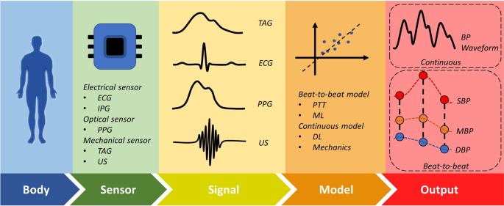
System Architecture
Arduino Nano 33 BLE for data collection.
Web application for data visualization.
Machine learning model for blood pressure predictions.

Slide 6
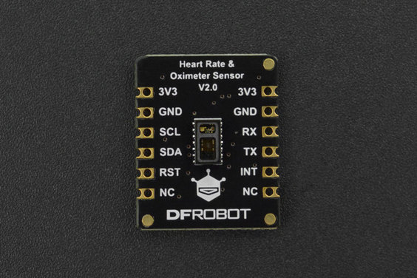

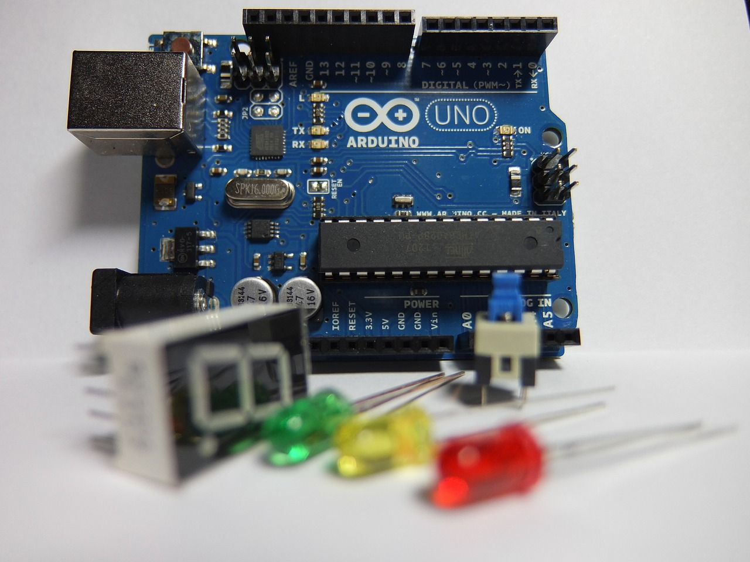
MAX30102 Heart Rate and Oximeter Sensor
Arduino Nano 33 BLE
Compact and highly integrated sensor module
Monitors heart rate and oxygen saturation (SpO2)
Used in wearable fitness trackers, medical devices, and healthcare monitoring systems
Compact and versatile microcontroller board
Equipped with Bluetooth Low Energy (BLE) connectivity
Includes a 9 axis inertial measurement unit (IMU)
Suitable for advanced robotics experiments, fitness trackers, digital compass applications

Slide 7
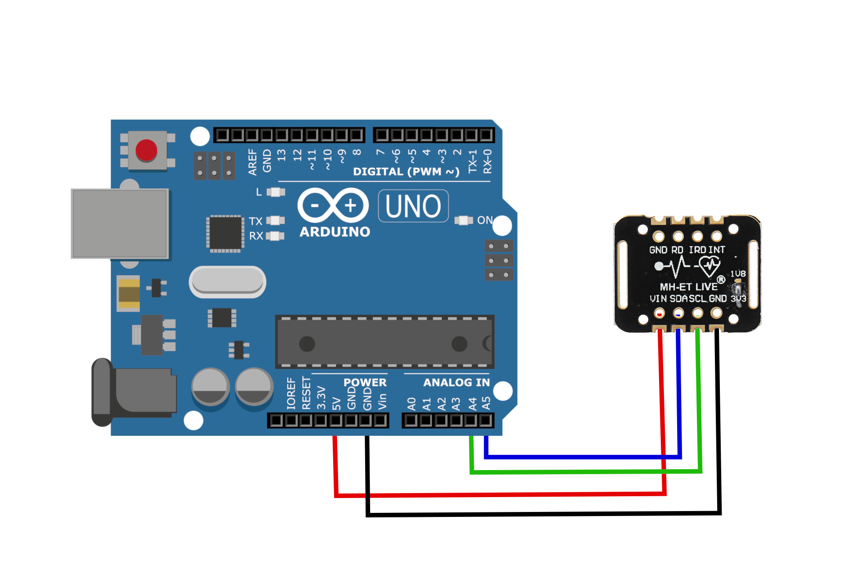
Connections
VCC pin to power source (3V to 5V)
GND pin for common ground
SCL pin to I2C clock pin
SDA pin to I2C data pin on Arduino board

Slide 8
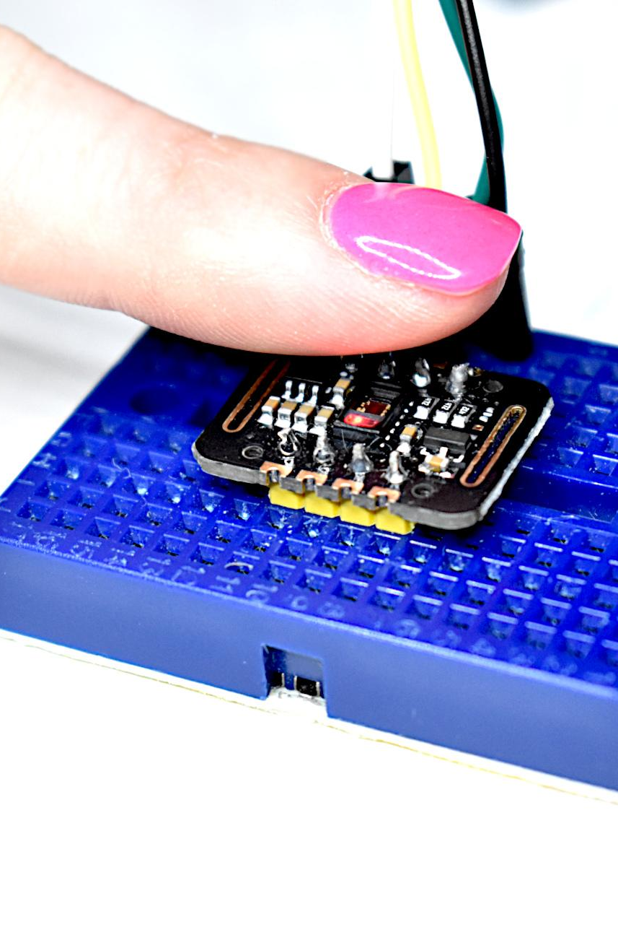
Data Collection
Simultaneous heart rate data collected from PPG signals using DFRobot Gravity MAX30102 sensor.
Arduino Nano 33 BLE for data collection.

Slide 9
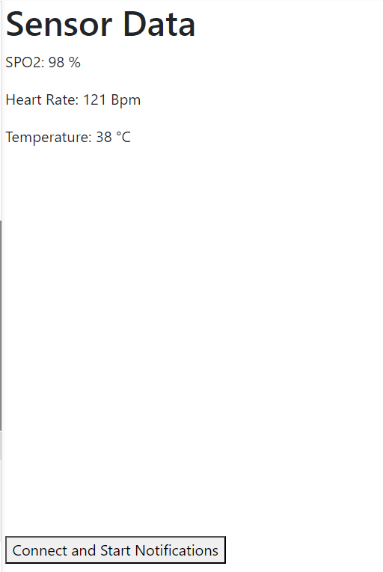
Data Output
Real-Time Health Metrics: The web application displays real-time health metrics captured by the Arduino Nano 33 BLE and the integrated sensor.
Graphical Representation: Utilizing plots and graphs, the web application offers graphical representations of vital health parameters such as heart rate.

Slide 10
Libraries Used:
DFRobot_BloodOxygen_S (Arduino library)
p5.ble.js (JavaScript library for BLE devices)
LightningChart JS (Data visualization library)

Slide 11
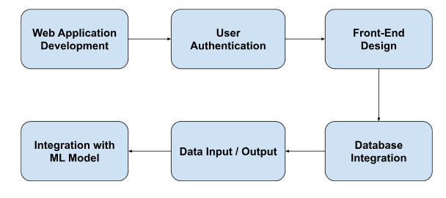
Web Application for User-Friendly Interface

Slide 12

Web Application (GUI)
User authentication implemented using Streamlit library.
Frontend design with Streamlit's widgets and custom CSS.
MySQL database for secure user management.
User can signUp/login and manage their profile details.

Slide 13
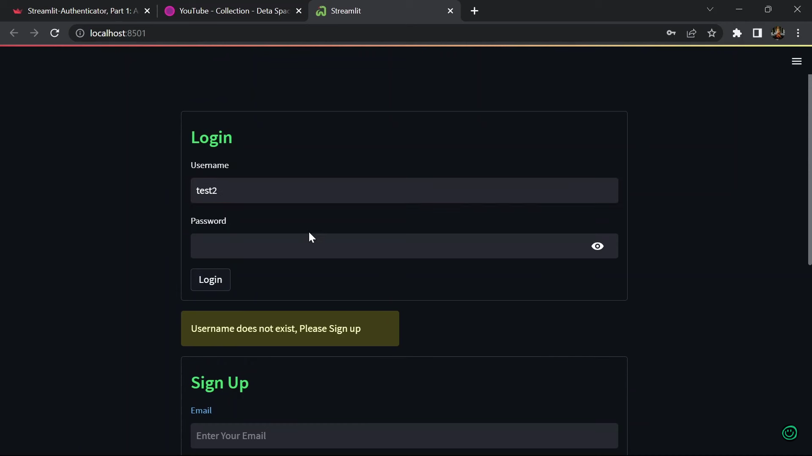
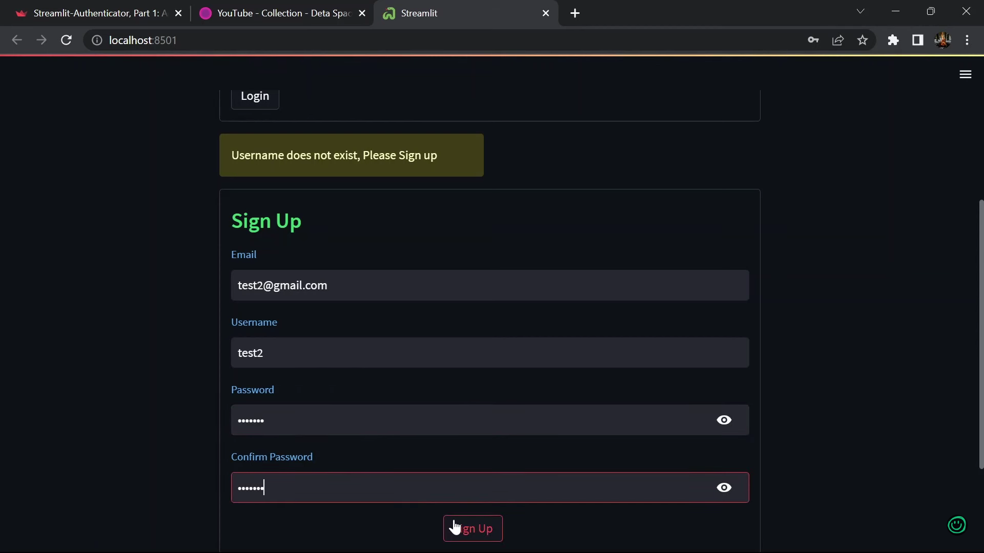
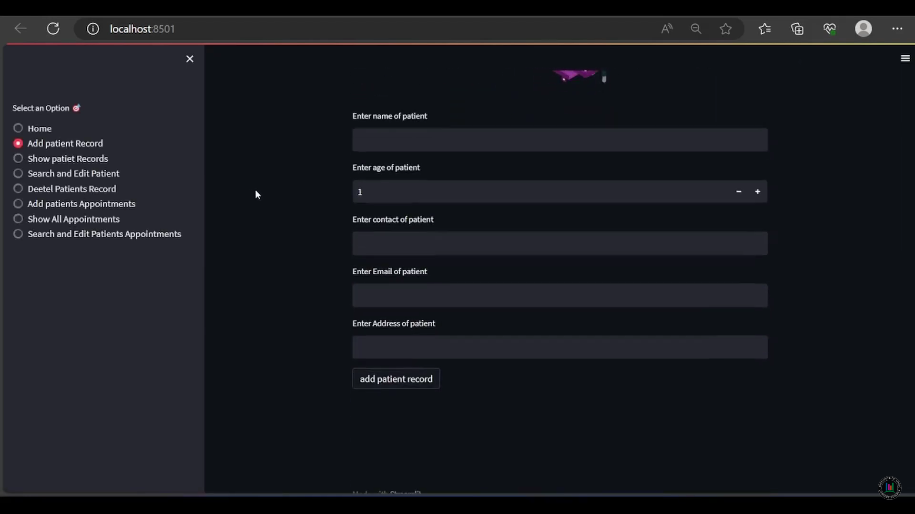
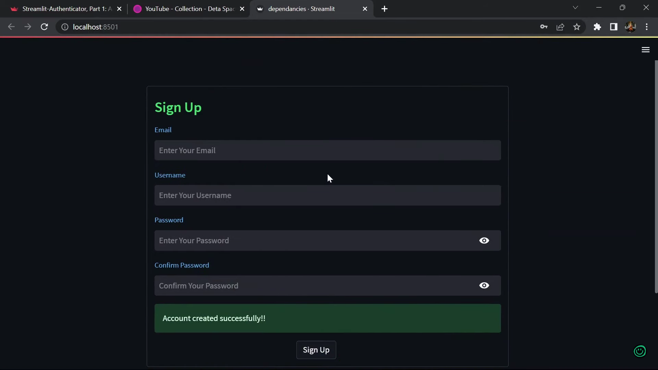
User login/signup
Account created
Add patient details

Slide 14
Dataset for BP Prediction
Dataset : Link
Signals organized as matrices or cell arrays, each cell representing a specific data segment.
Matrices have rows corresponding to distinct signal channels:
PPG signal (125Hz) sourced from the fingertip's photoplethysmograph.
ABP signal (125Hz) represents invasive arterial blood pressure in mmHg.
ECG signal (125Hz) originates from channel II of the electrocardiogram.

Slide 15
Machine Learning Model
Linear Regression Model
We start by building a simple Linear Regression model. The dataset is split into training and testing sets. A 5-fold cross-validation is performed on the training data to assess the model's performance. Mean squared error is used as the evaluation metric.
The average RMSE (Root Mean Squared Error) over the 5 folds is found to be 27.34512297194153. This metric measures the error in predicting BP values.

Slide 16
Machine Learning Model
Neural Network (Deep Learning) Model
The deep learning model used in our project is a feedforward neural network. It consists of multiple layers, including dense (fully connected) layers, activation functions, and dropout layers.
The training process involves feeding the neural network with input data (PPG features) and target labels (actual blood pressure values) and iteratively updating the model's parameters to minimize the Huber loss.

Slide 17
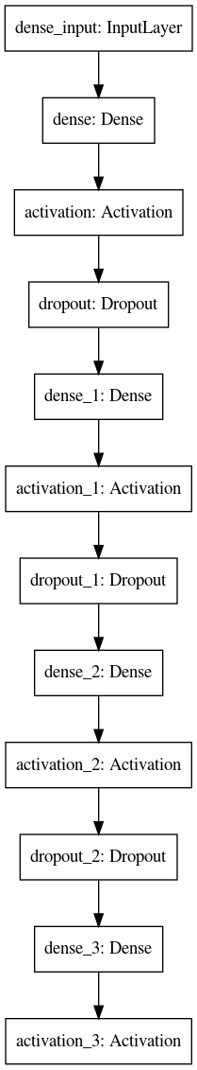
Model Architecture
Input Layer: Neurons match the features in our PPG signal data.
Dense Layers: These layers learn intricate patterns in the input data.
Layer 1 (1024 neurons): Employs ReLU activation.
Layer 2 (512 neurons): Also uses ReLU activation.
Layer 3 (64 neurons): Utilizes ReLU activation.
Dropout Layers: Introduced to prevent overfitting by randomly dropping neurons during training.
Output Layer: Has one neuron for regression (blood pressure prediction) with a 'linear' activation function.

Slide 18
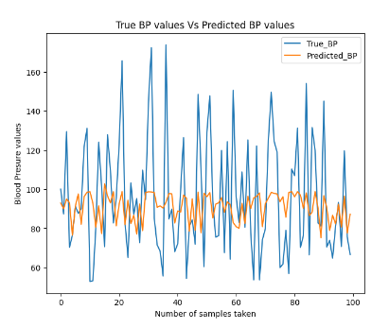
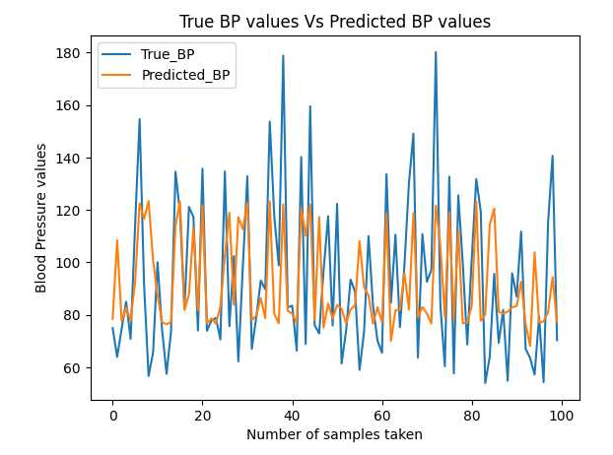
Results
Linear Regression Model
Neural Network (Deep Learning) Model

Slide 19
Future Scope & Conclusion
The ongoing development involves the creation of a machine learning model dedicated to blood pressure prediction. Future work will focus on seamlessly integrating this machine learning model into the web application.
The potential expansion of features within the machine learning model is being explored, including additional health indicators or refinements to enhance overall predictive capabilities.
Explore integration possibilities with wearable devices to facilitate continuous blood pressure monitoring in daily life, contributing to long-term health management.

Slide 20
Thank you for your time and attention

